Slide 1

Handwritten CAPTCHA for Authentication https://github.com/UmaMaheswari-Manchineella/Handwritten-CAPTCHA-for-Authentication
Batch No: B-02 Project Guide:
M.Uma Maheswari (164G1A05B4) Mr. Lingam Suman,_{M.Tech}
H.Sai Lavanya (164G1A0587) Assistant Professor`
C.Pavani (164G1A0565)
C.Vamsi Krishna (164G1A05B6)
Srinivasa Ramanujan Institute of Technology
Department of Computer Science & Engineering

Slide 2
Abstract
A Turing test is a method of inquiry for determining whether or not a computer is capable of thinking like a human being.
This test is useful for web based application in the form of CAPTCHA (Completely Automated Public Turing Test to tell Computers and Humans Apart) to prevent from automated access and the harms caused by the bots.
The motive of this proposed CAPTCHA is to review the existing CAPTCHA techniques and provide best level of security using handwritten CAPTCHA that is very difficult to be cracked and able to replace the existing systems.

Slide 3
We take the handwritten symbols or digits from the user in the form of image and at the same time we are not allowing any bots to submit them and hence, we validate the user submitted handwritten symbols or digits using CNN.
Convolutional Neural Network is primarily used in object recognition by taking images as input and then classifying them .
The level of complexity which has been merged in the proposed CAPTCHA may let the human to solve it but it becomes quite difficult to bots.

Slide 4
Existing System
During the survey, it has been observed that every system has different form of CAPTCHA to secure the server but the techniques proposed so far are lacking somewhere.
Some systems are often simple to recognize and get affected by web attacks and others are much difficult to solve even for human.

Slide 5
Proposed System
We present the application which focuses on defending online services against abusive attacks.
Our goal is to introduce "Handwritten CAPTCHAs" as an automated recognition test that is designed to allow humans to pass with little effort but where the state-of-the-art computer programs fail.

Slide 6
Problem Definition
CAPTCHA-Completely Automatic Public Turing test to tell Computers Humans Apart is a test that can distinguish human users from computer/robots.
We are developing the most secure captcha for authentication purpose that is very difficult to crack by the attackers.

Slide 7
Convolutional Neural Network
CNN is a very powerful algorithm which is widely used for image classification and object detection.
The powerful feature extraction capabilities from an image makes CNN a very robust algorithm for various image and object recognition tasks.

Slide 8
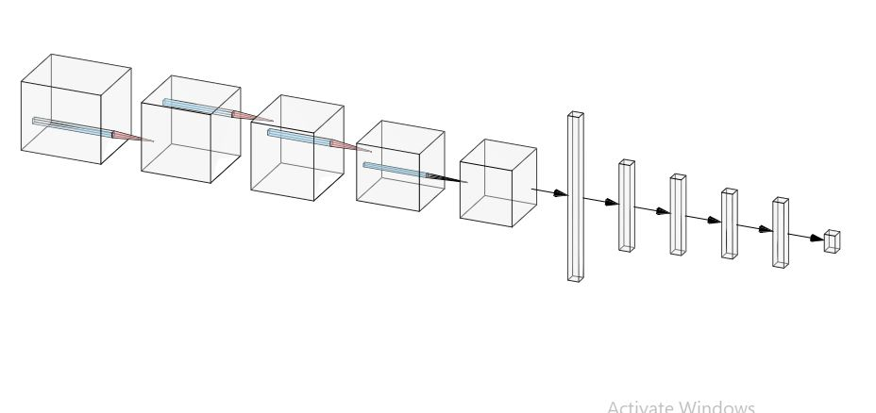

CNN Model Architecture
CN
CN
MP
FL
CN
DN
DN
DN
DR
DN
CN – Convolution
MP – Max Pooling
FL – Flatten
DN – Dense
DR – Dropout

Slide 9
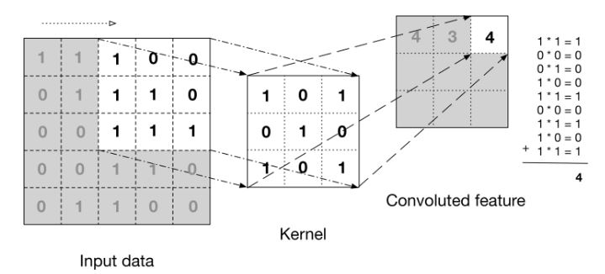
Convolution Layer

Slide 10
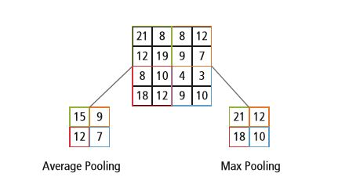
Pooling Layer

Slide 11
ReLU Layer
A node or unit that implements the activation function is referred to as a Rectified Linear activation Unit, or ReLU for short.
The rectified linear activation function is a piecewise linear function that will output the input directly if is positive, otherwise, it will output zero.
It has become the default activation function for many types of neural networks because a model that uses it is easier to train and often achieves better performance.

Slide 12
Fully Connected Layer
The objective of a fully connected layer is to take the results of the convolution/pooling process and use them to classify the image into a label (in a simple classification example).
The output of convolution/pooling is flattened into a single vector of values, each representing a probability that a certain feature belongs to a label.

Slide 13
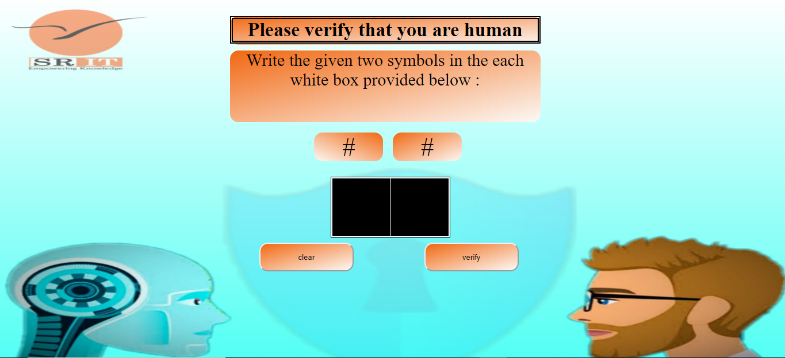
Output

Slide 14
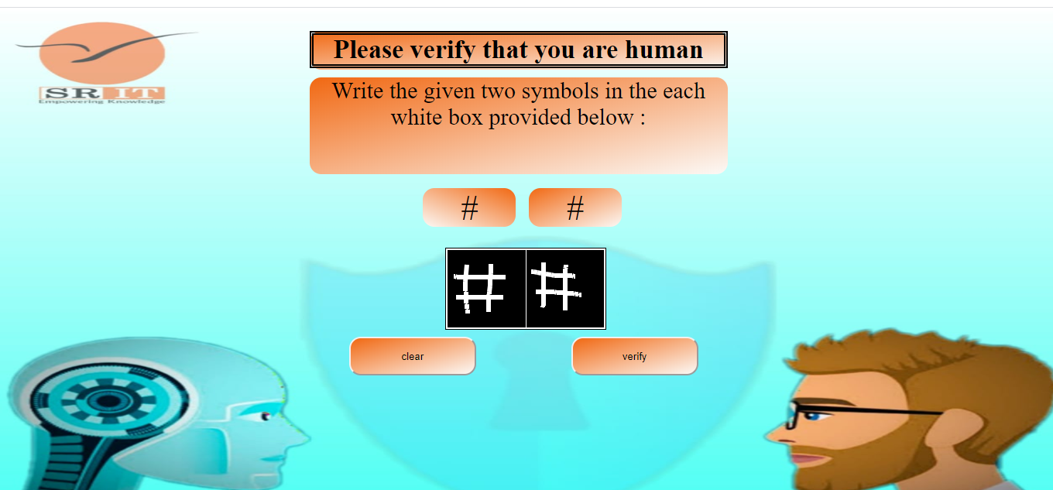
Submitting the CAPTCHA

Slide 15
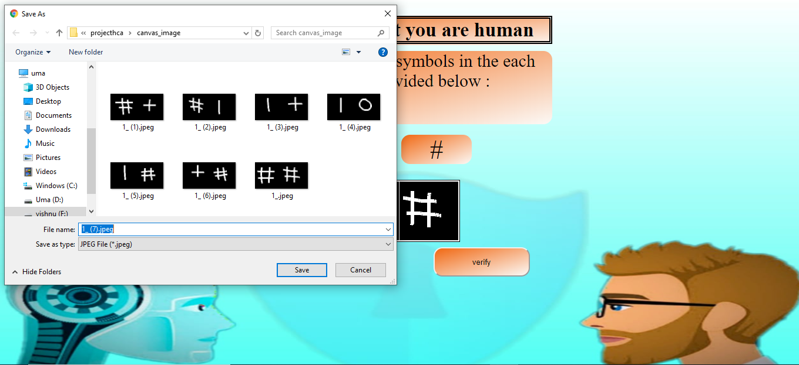
Downloading Canvas Image

Slide 16
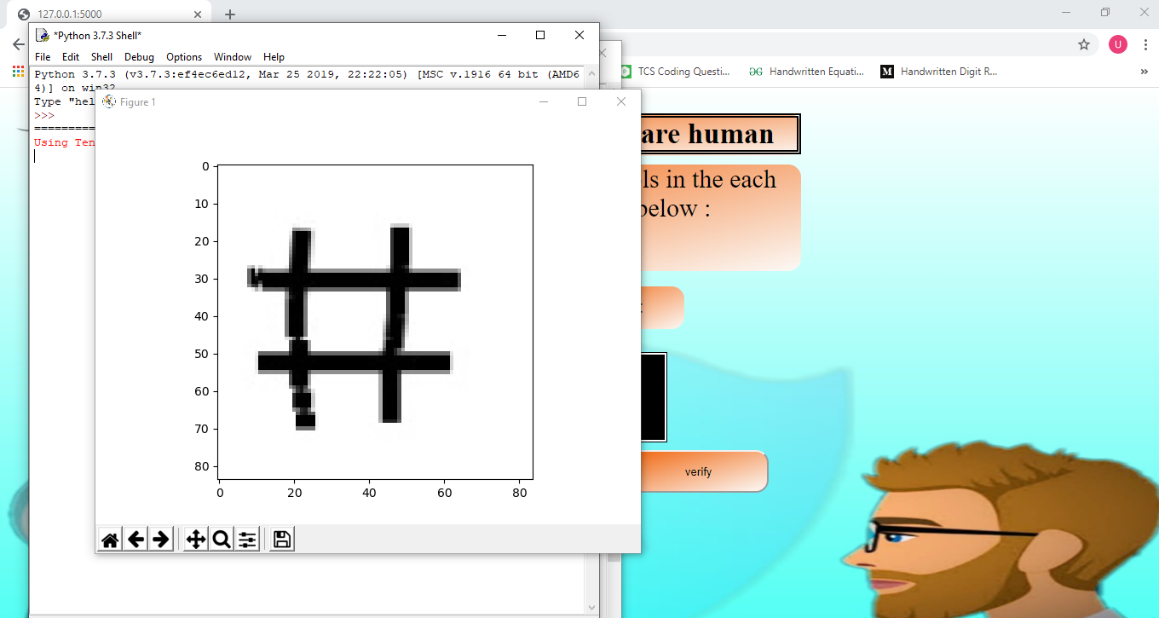

Slide 17
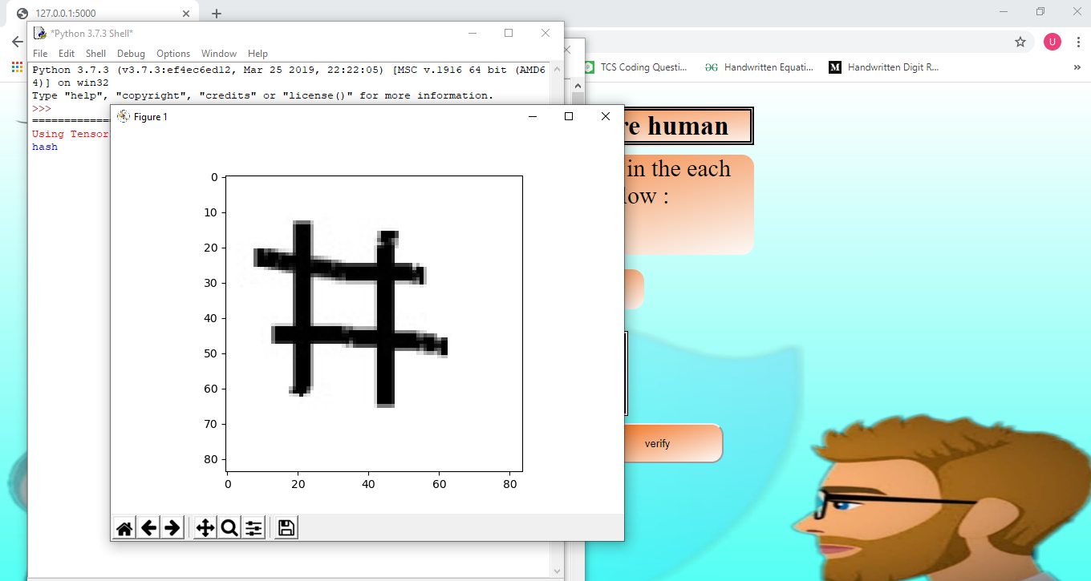

Slide 18
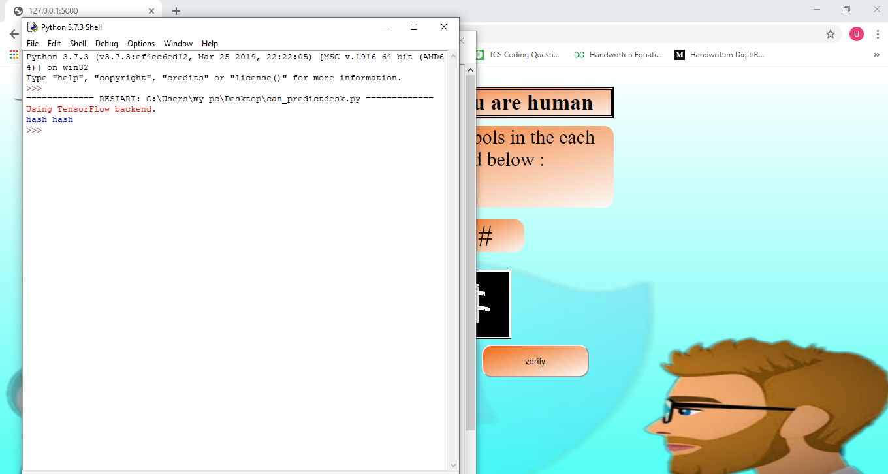
Predicting the Labels

Slide 19
References
[1] Chen, Jun & Luo, Xiangyang & Guo, Yanqing & Zhang, Yi & Gong, Daofu. (2017). A Survey on Breaking Technique of Text-Based CAPTCHA. Security and Communication Networks. 2017. 1-15. 10.1155/2017/6898617. “A Survey on Breaking Technique of Text-Based CAPTCHA”
[2] Suphannee Sivakorn, Iasonas Polakis and Angelos D. Keromytis Department of Computer Science Columbia University, New York, USA “Am Robot:(Deep)Learning to Break Semantic Image CAPTCHAs”
[3] Anuj Dutt, Aashi Dutt .International Journal of Advanced Research in Computer Engineering & Technology (IJARCET) July 2017, ISSN: 2278 – 1323 . “Handwritten Digit Recognition Using Deep Learning”

Slide 20
Thank you
Queries
?

